Slide 1
Edgar Degas
Summer 1
Cycle 2

Slide 2
Who was Edgar Degas?
Edgar Degas
Born July 19, 1834
Died September 27, 1917
Edgar Degas studied at the École des Beaux-Arts in Paris and became known as a great portraitist. Both a painter and sculptor, Degas enjoyed capturing female dancers and played with unusual angles and ideas around centering. His work influenced several major modern artists, including Pablo Picasso.
Degas came from a very musical household – his mother was an amateur opera singer and his father occasionally arranged for musicians to give recitals in their home. Degas attended the Lycée Louis-le-Grand, a prestigious and rigorous boys' secondary school, where he received a classical education.
https://www.tate.org.uk/kids/explore/who-is/who-edgar-degas Explore Edgar Degas here!

Slide 3
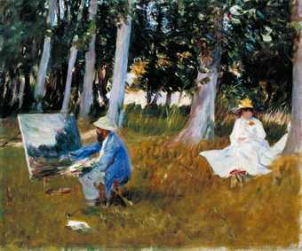
Impressionism
What is impressionism?
https://www.tate.org.uk/kids/explore/what-is/impressionism
Before impressionism, landscapes in art were often imaginary, perfect landscapes painted in the studio. The impressionists changed all that. They painted outdoors.
As they were outside, they looked at how light and colour changed the scenes. They often painted thickly and used quick (and quite messy) brush strokes. In most of the paintings before impressionism you can't really see the brushstrokes at all.

Slide 4
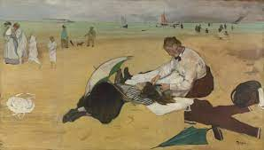
Edgar Degas ~ Beach Scene
What is the girl/maid thinking?
What can you see in the painting?
Notes:
A maid combs the hair of a girl who has been swimming; her bathing suit is stretched out on the ground to dry. Other objects – two parasols, a basket and a summer bonnet – are scattered around. A family group (some members wrapped in towels) is leaving the shoreline, as other people stroll in the distance.
This is one of four beach scenes that Degas painted in around 1869, when he travelled to the coast of northern France, although he later stated that the picture had been completed in the studio. Small paintings of beach and seaside scenes in resorts such as Trouville were popular with several of Degas’s contemporaries, including Boudin, Monet and Manet.
Degas was a great admirer of Japanese prints, and adopted many aspects of their composition as well as their subject matter. The motif of a woman combing her hair or having it combed, which features in many Japanese prints, became part of his repertoire.

Slide 5
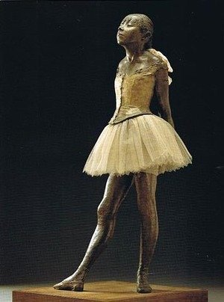
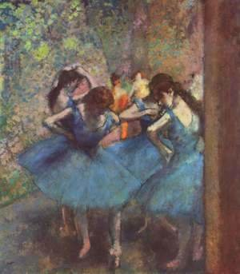
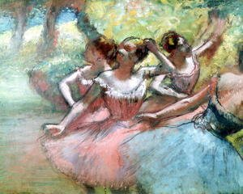
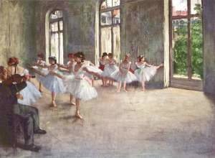
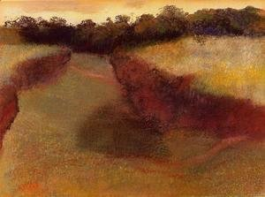
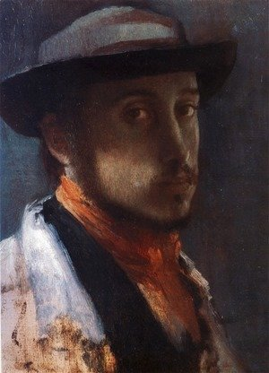
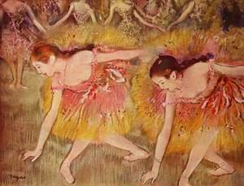
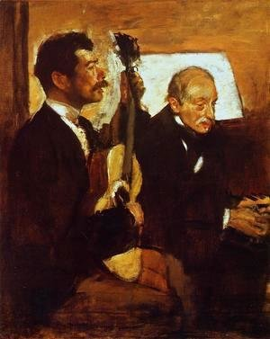
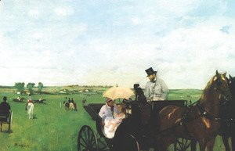
Other examples of Degas’ work

Slide 6
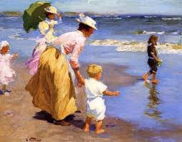
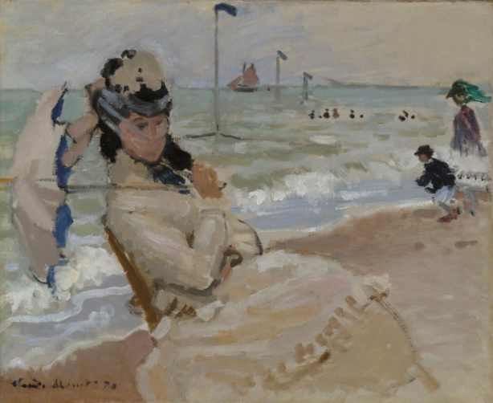
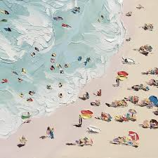
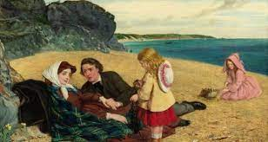
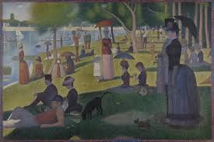
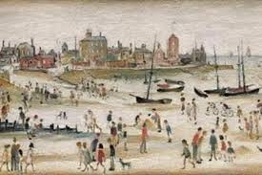
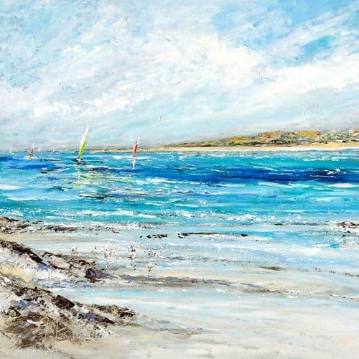
Other beach scenes
Claude Monet
Georges Seurat

Slide 7
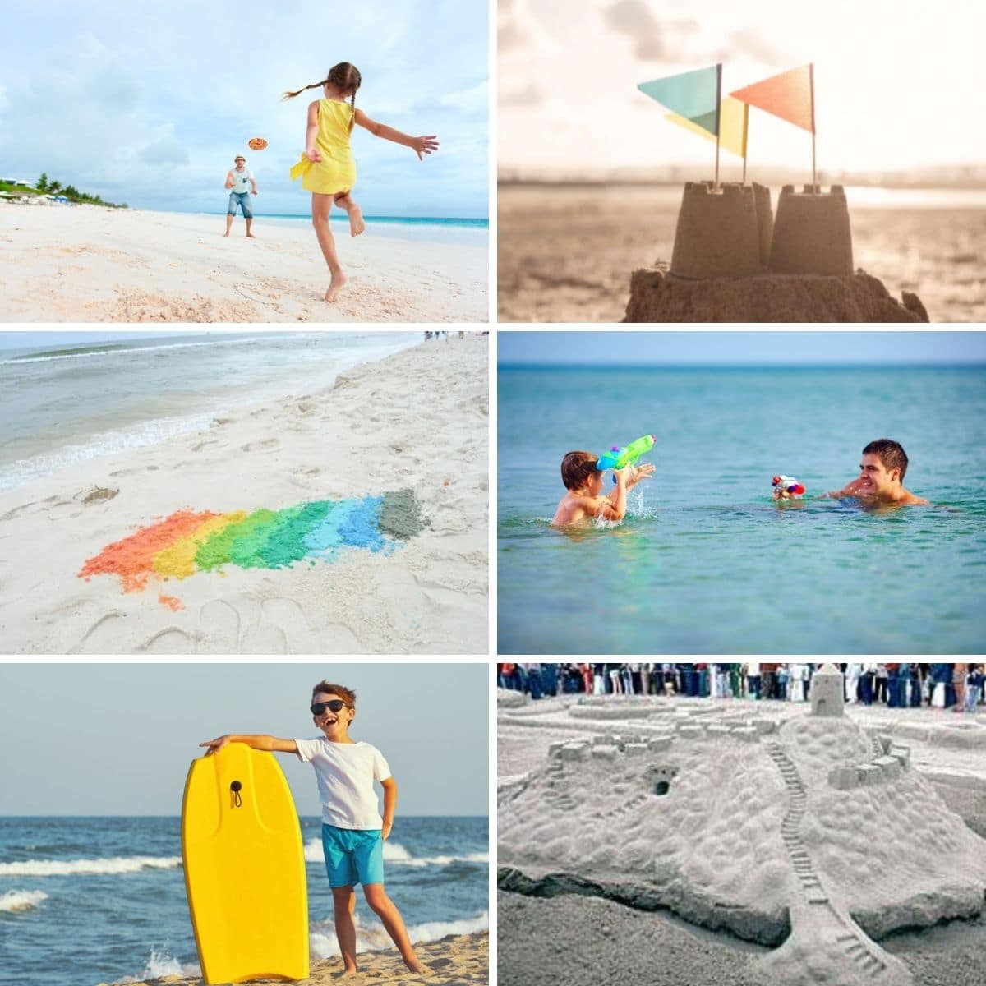
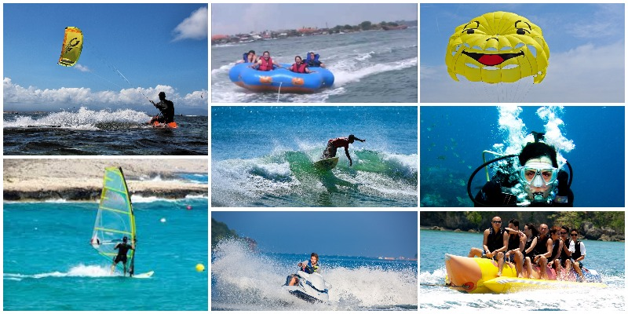
What things do we do at the beach?

Slide 8
Powder paints
How to mix powder paints – D D D
Dip your paintbrush in the water
Dab your paintbrush gently in the powder paint
Do oodle do your paint around the pallet

Slide 9
Exploring powder paints….
First dip into the yellow then begin to add small amounts of red. What do you notice?
How many different types of orange can you make?
What happens if you add more yellow?
What happens if you add more red?

