Slide 1
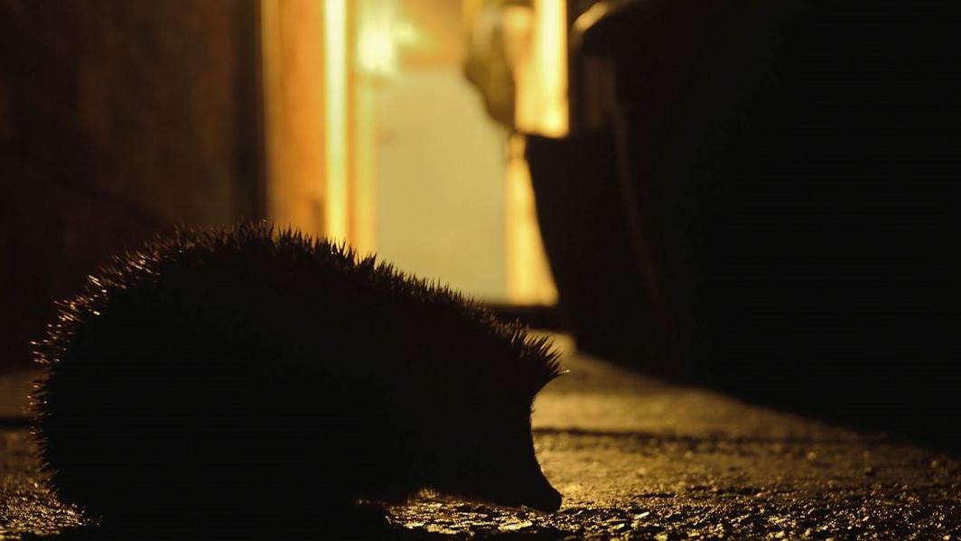
Nocturnal Animals
What does nocturnal mean?
Which animals are nocturnal?
Why are some animals nocturnal?

Slide 2

What is a nocturnal animal?
Nocturnal animals are awake and active during the night and rest during the day!
Whether you live in the country or a busy city, wildlife is all around, all the time.
If you keep your eyes and ears open, there's loads of nocturnal nature to be found.
Here are some facts about night-time wildlife...

Slide 3
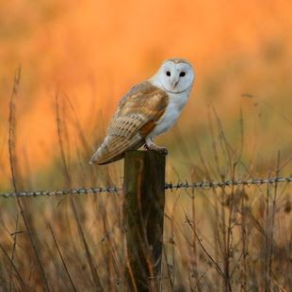
Owls
Most owls are nocturnal; they are awake and active when it goes dark (dusk) until the sun starts to come up in the morning (dawn).
This is a barn owl; it has a heart-shaped face with a golden-coloured back and wings. It is pure white underneath.
At night you may catch a glimpse of the barn owl's silhouette as it glides through the twilight hunting for food.
Let’s listen to an owl - read and hear more about night-time sound

Slide 4
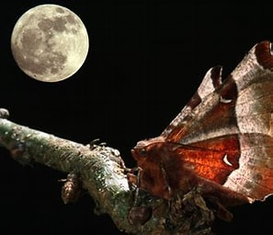
Moths
Moths are insects.
Most moths come out at night.
They can be confused with butterflies but moths are usually brown and butterflies are more colourful.
Moths collect nectar at night.
They have a long curled tongue called a probiscis and suck the nectar from the flower, (a bit like drinking from a straw). They take it to other parts of the plant, which mean more can grow!

Slide 5
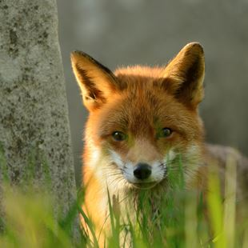
Foxes
Foxes are active during the night, when they can generally be found alone, searching for food.
They are common, with more and more choosing to live in towns as well as country areas.
Foxes are part of the dog family and are shy animals.
Fox families live in homes under the ground called dens.
The call of the fox is a strange sound, let’s listen- read and hear more about night-time sounds.

Slide 6
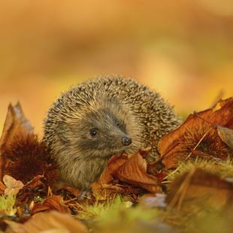
Hedgehogs
Hedgehogs have short legs and a round body covered in short, dark, yellow-tipped spines.
If you're lucky, you may spot a hedgehog looking for insects to eat in your garden, when it is going dark.
Use a torch in your garden to see if you can spy one. Listen, too - they make funny grunting noises as they move about!
Despite having bad eyesight, hedgehogs have a very good sense of hearing and smell, which they use on their night time adventures!
You can help give hedgehogs a home by building a hog-home with an adult.

Slide 7
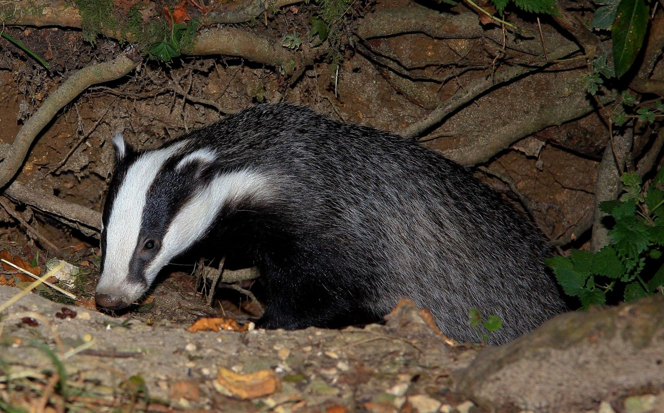
Badgers
Badgers are active at night and sleep during the day.
It would be easy to recognise a badger with their black and white-striped faces but badgers are very shy!
They mostly live in woods, in underground burrows called 'setts’. They dig these burrows with their strong legs and sharp claws
Male badgers are called 'boars’, a female badger is a ‘sow’ and a group of badgers is called a 'clan'.
Badgers eat meat and plants but their favourite food is a juicy worm!

Slide 8
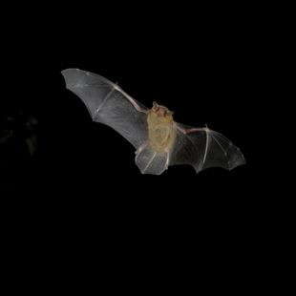
Bats
If you look up when it is just going dark (dusk) you might notice a bat flying quickly across the sky.
They are smaller than a bird, with reddish-brown fur and black ears, nose and wings.
Bats are nocturnal, coming out at night for a couple of hours to hunt for insects to eat.
Then they return to their roosts on a house, tree or building.
Bats are fast fliers. They like to fly where there are trees.

