Slide 1



TINGATINGA
ART

Slide 2
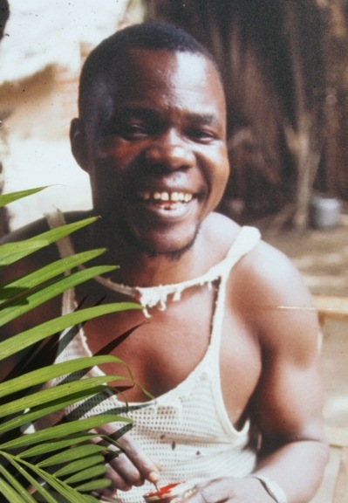
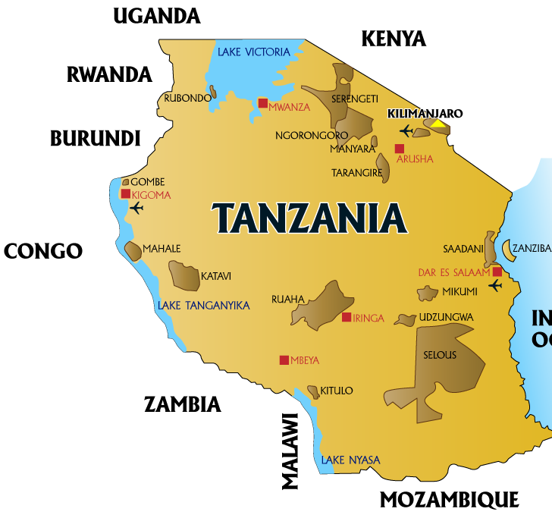
Tingatinga art was first created in Tanzania, East Africa in the 1960’s. It all began with a man called Edward Saidi Tingatinga.

Slide 3
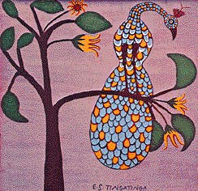
Unemployed and desperate to earn some money, Edward Tingatinga decided to try and paint pictures to sell to tourists visiting Tanzania.
He used bicycle paint and painted on old, square ceiling tiles.
Peacock in a Tree, E.S. Tingatinga

Slide 4
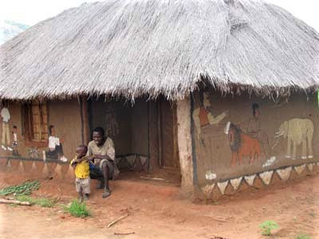
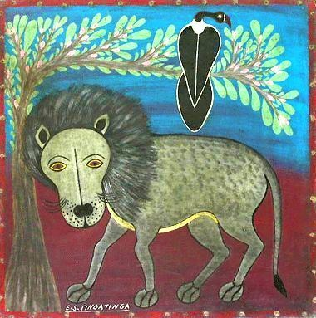
Edward Tingatinga painted pictures of African wildlife in a simple style, similar to that found on traditional mud huts. The tourists loved his artwork and it became very popular.
E.S. Tingatinga

Slide 5
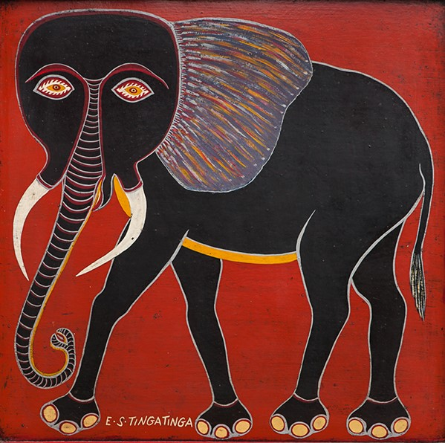
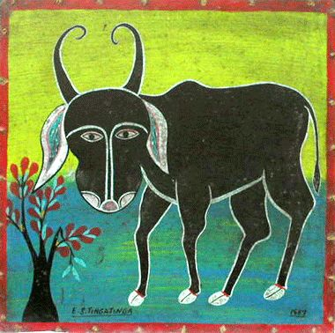
Edward Tingatinga soon spent all of his time painting and began teaching other people how to paint in his style too.
Elephant, E.S. Tingatinga
Wildebeest, E.S. Tingatinga

Slide 6
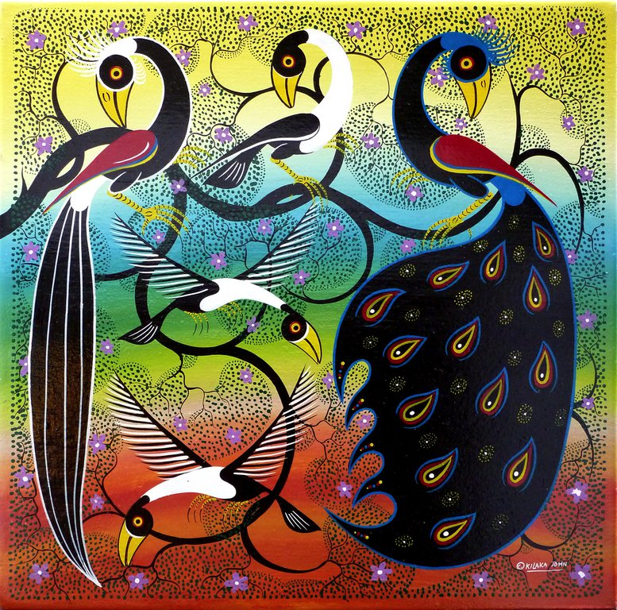
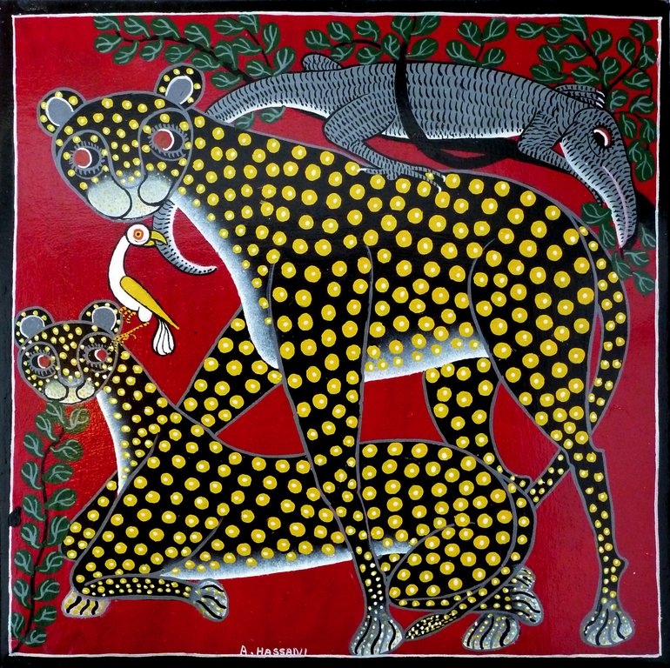
This type of painting became very popular and lots of artists began imitating Edward Tingatinga’s style, it even started being copied in neighbouring countries! The style became known as Tingatinga art.
Peacock in a Tree, Kilaka
Cheetahs, Hassani

Slide 7
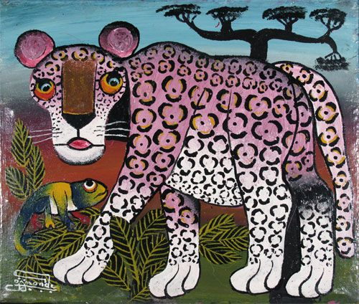
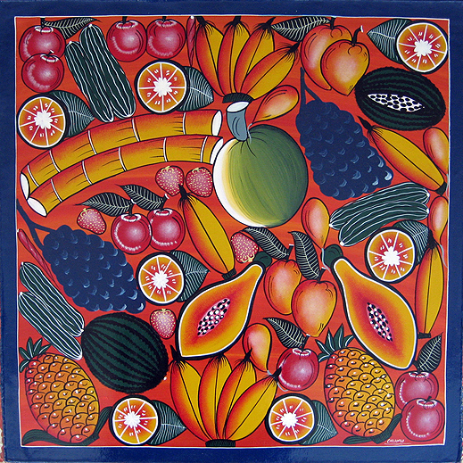
Over time, artists have developed Tingatinga art to include more colours and patterns. Many still use bicycle paint but, some now use oil paint too.
Pink Leopard, Omary Amonde
Fruit Heaven 1, Chilambo

Slide 8
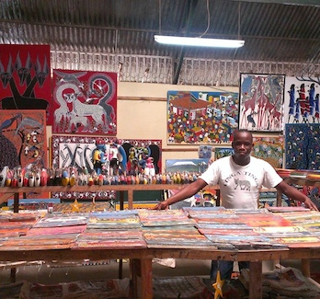
When Edward Tingatinga died his students, relatives and followers of his work set up a co-operative so that they could make and sell Authentic Tingatinga paintings together.
The co-operative still exists today to teach and promote Tingatinga art to the world.
TACS studio, Tanzania

Slide 9
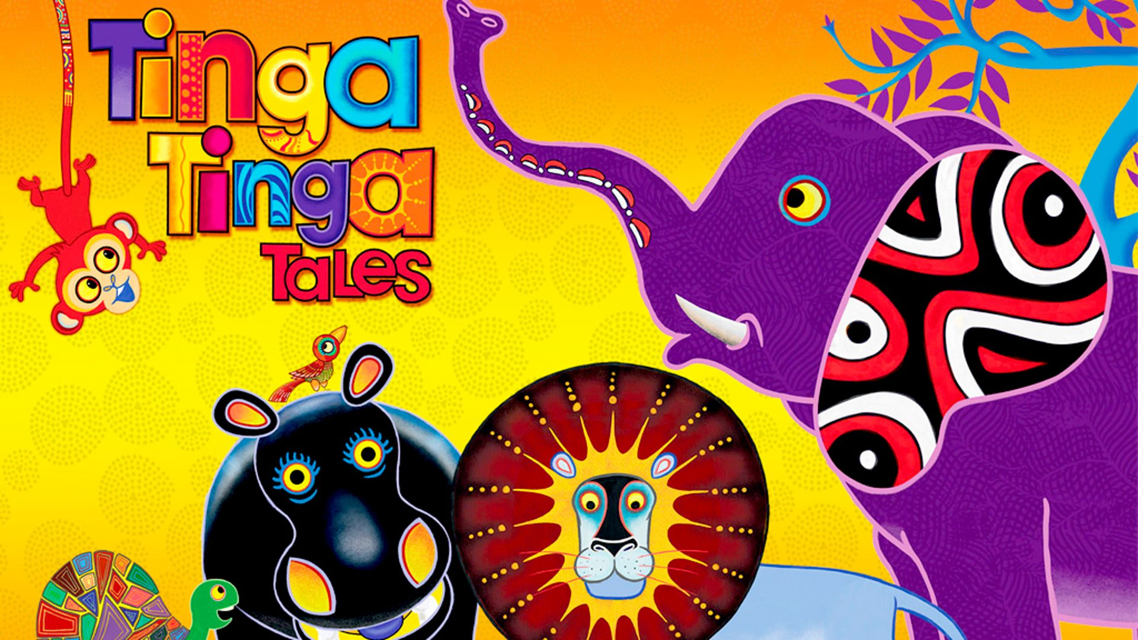
Tingatinga art continues to be very popular. A children’s television series based on African folk tales used its style and even took its name!
Have you seen it?

Slide 10
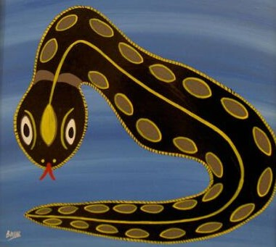


Art from Africa
www.artylingua.com
Artwork from:
thorupart.com
Insideafricanart.com
Tingatingaart.ch

